Slide 1
(SeisMike)
A Modular, Air-Coupled Seismic and Multi-sensor Platform for Near-Surface Geophysical Evaluation

Slide 2
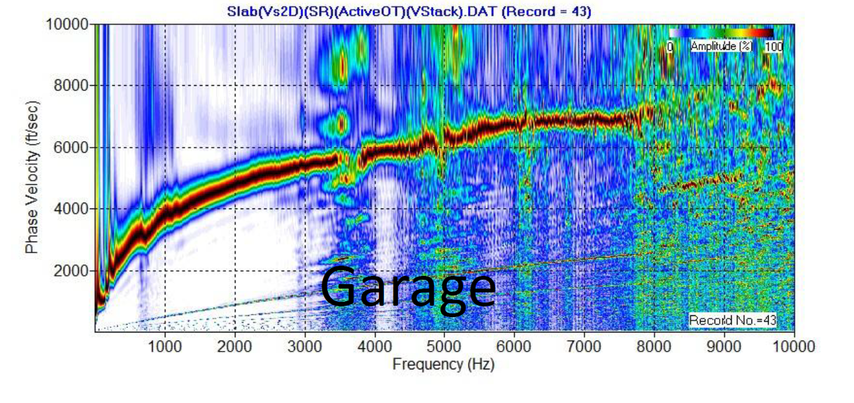
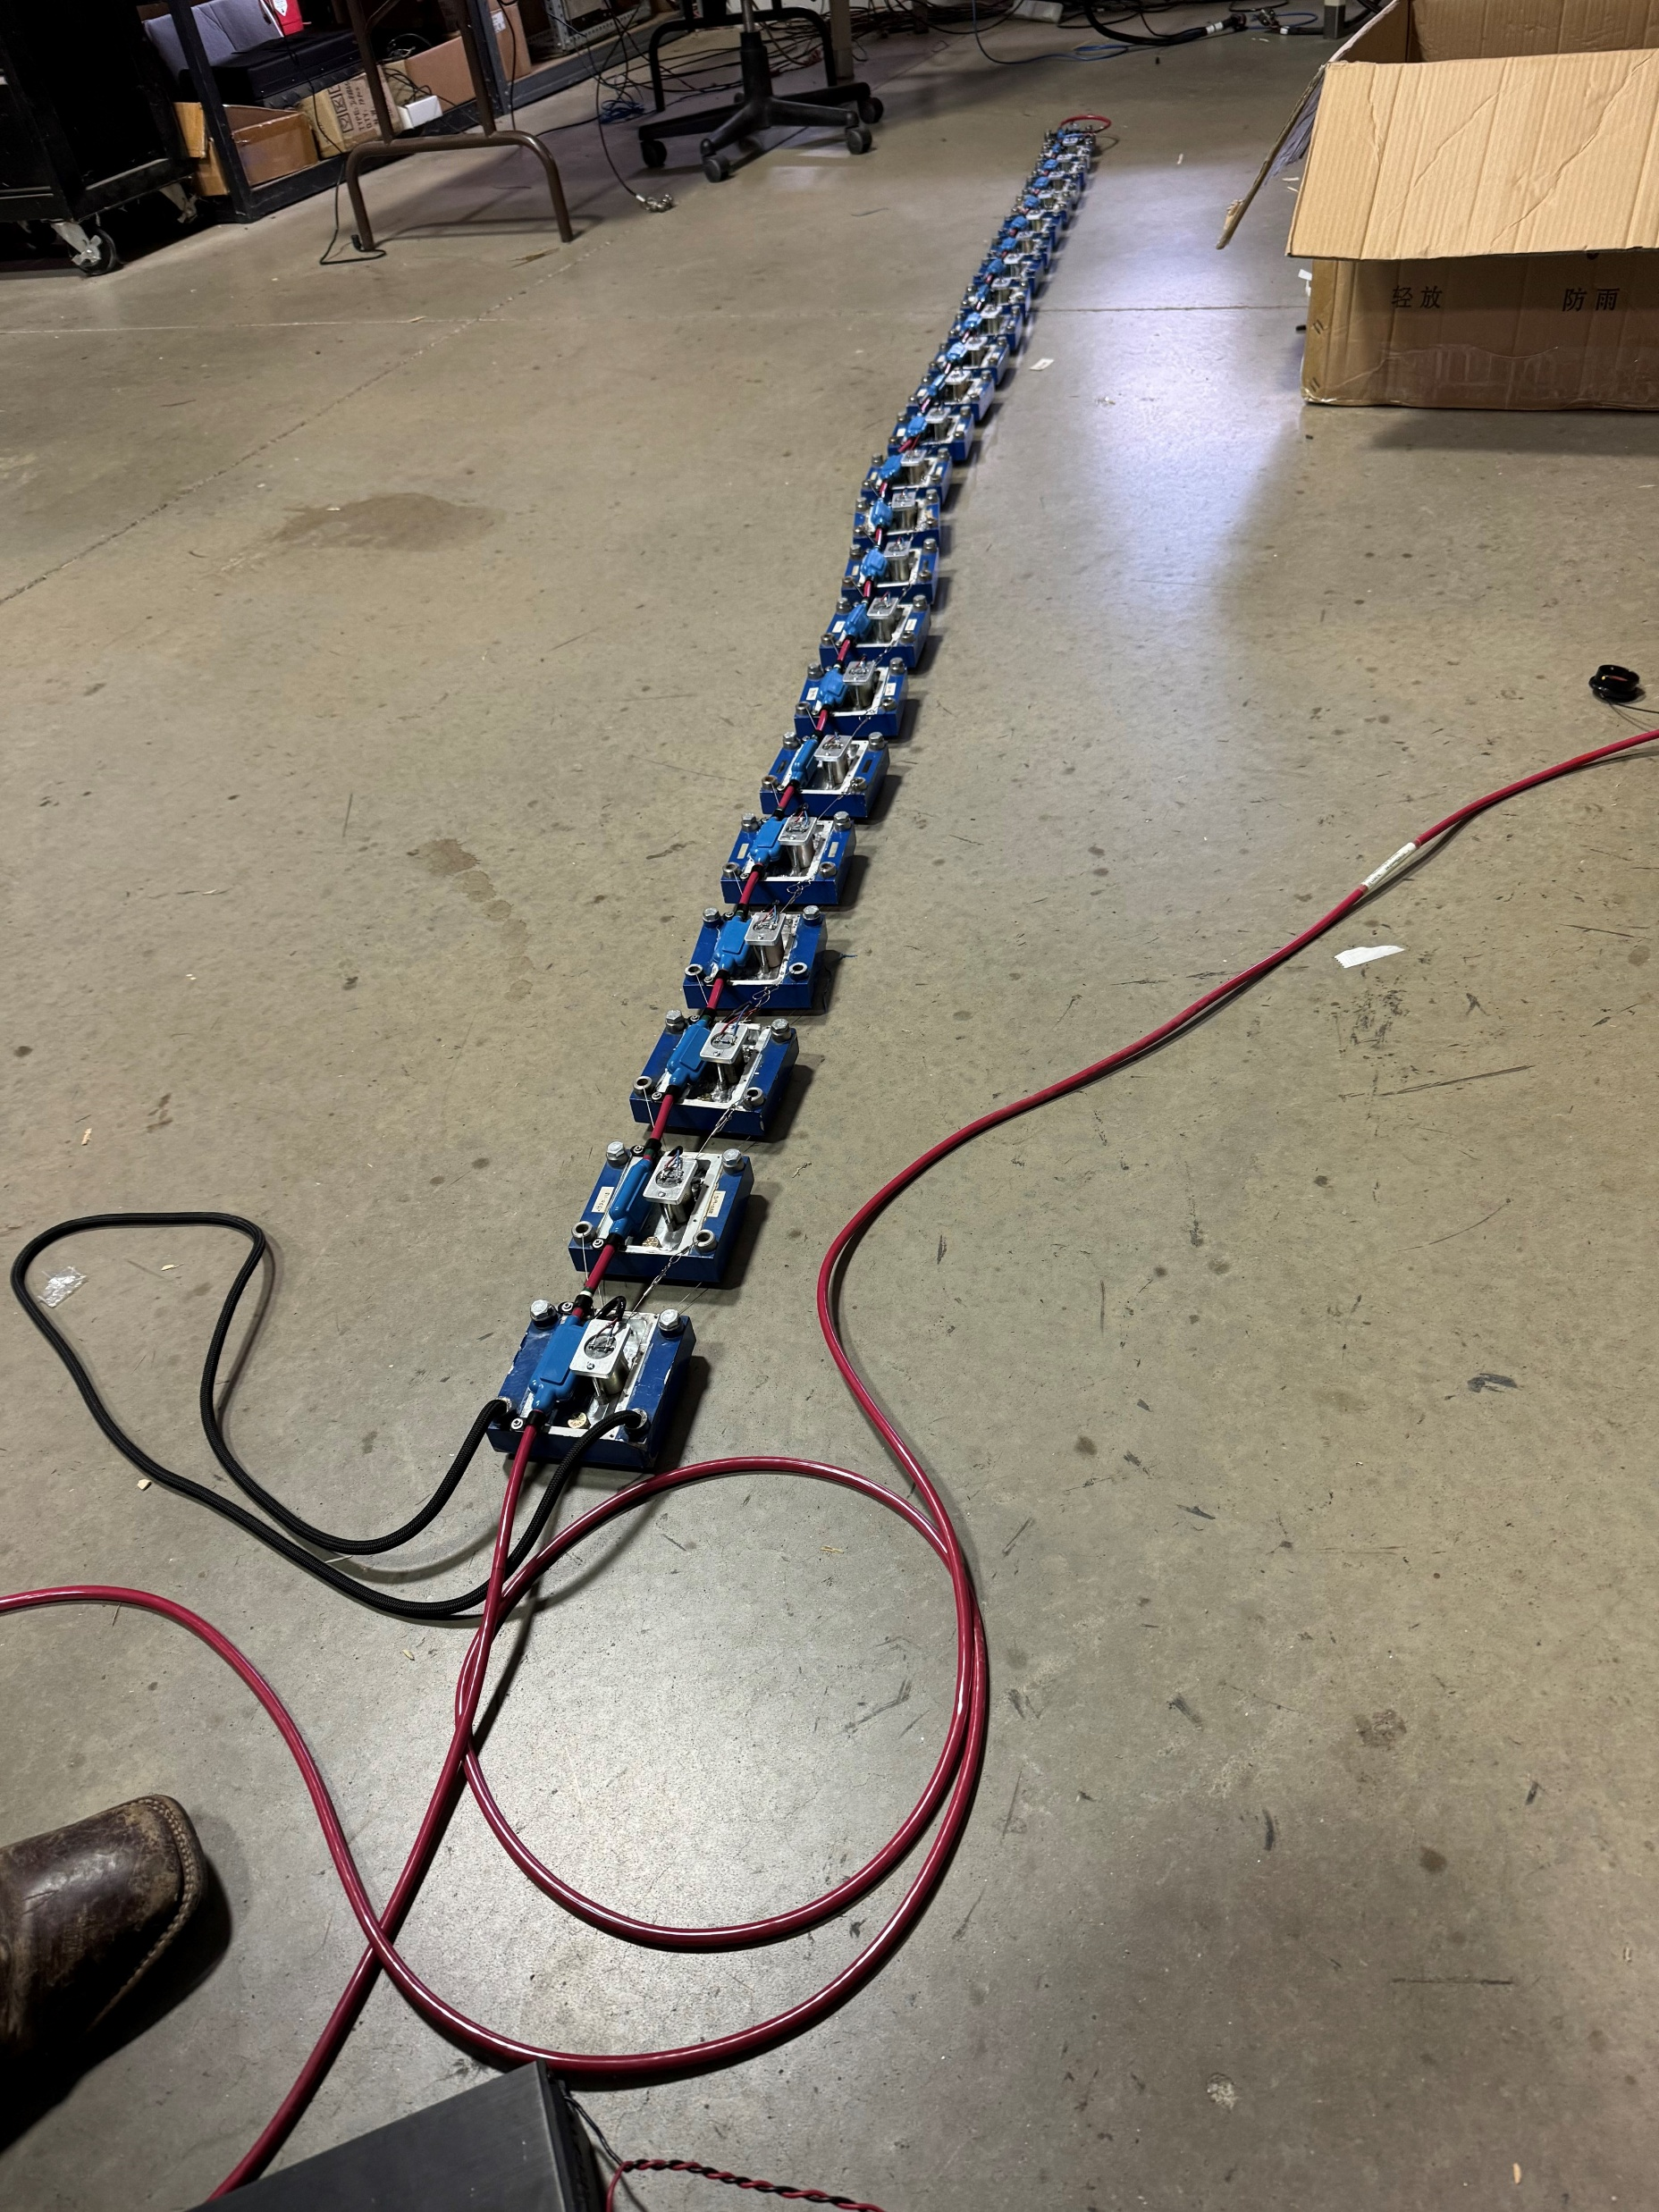
6” 10Hz geophone streamer on sleds

Slide 3
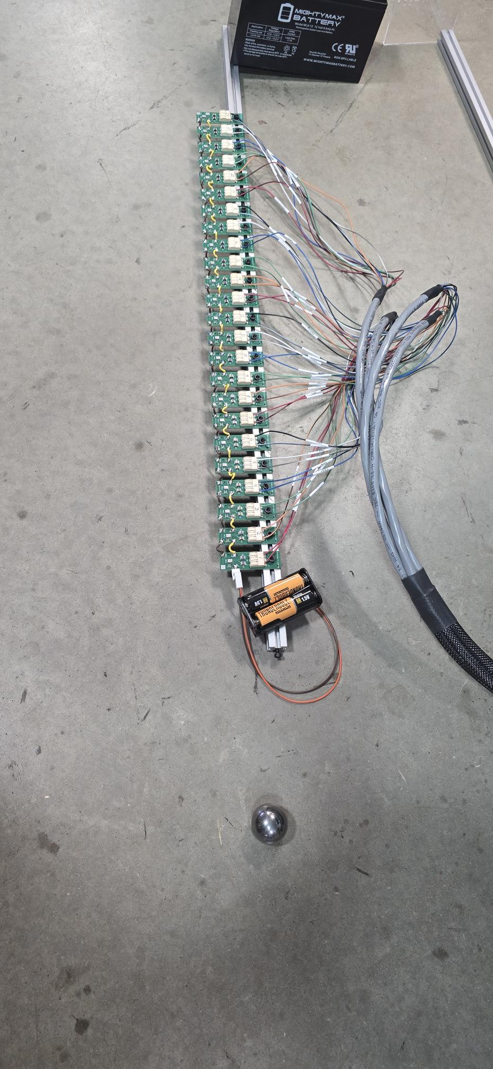
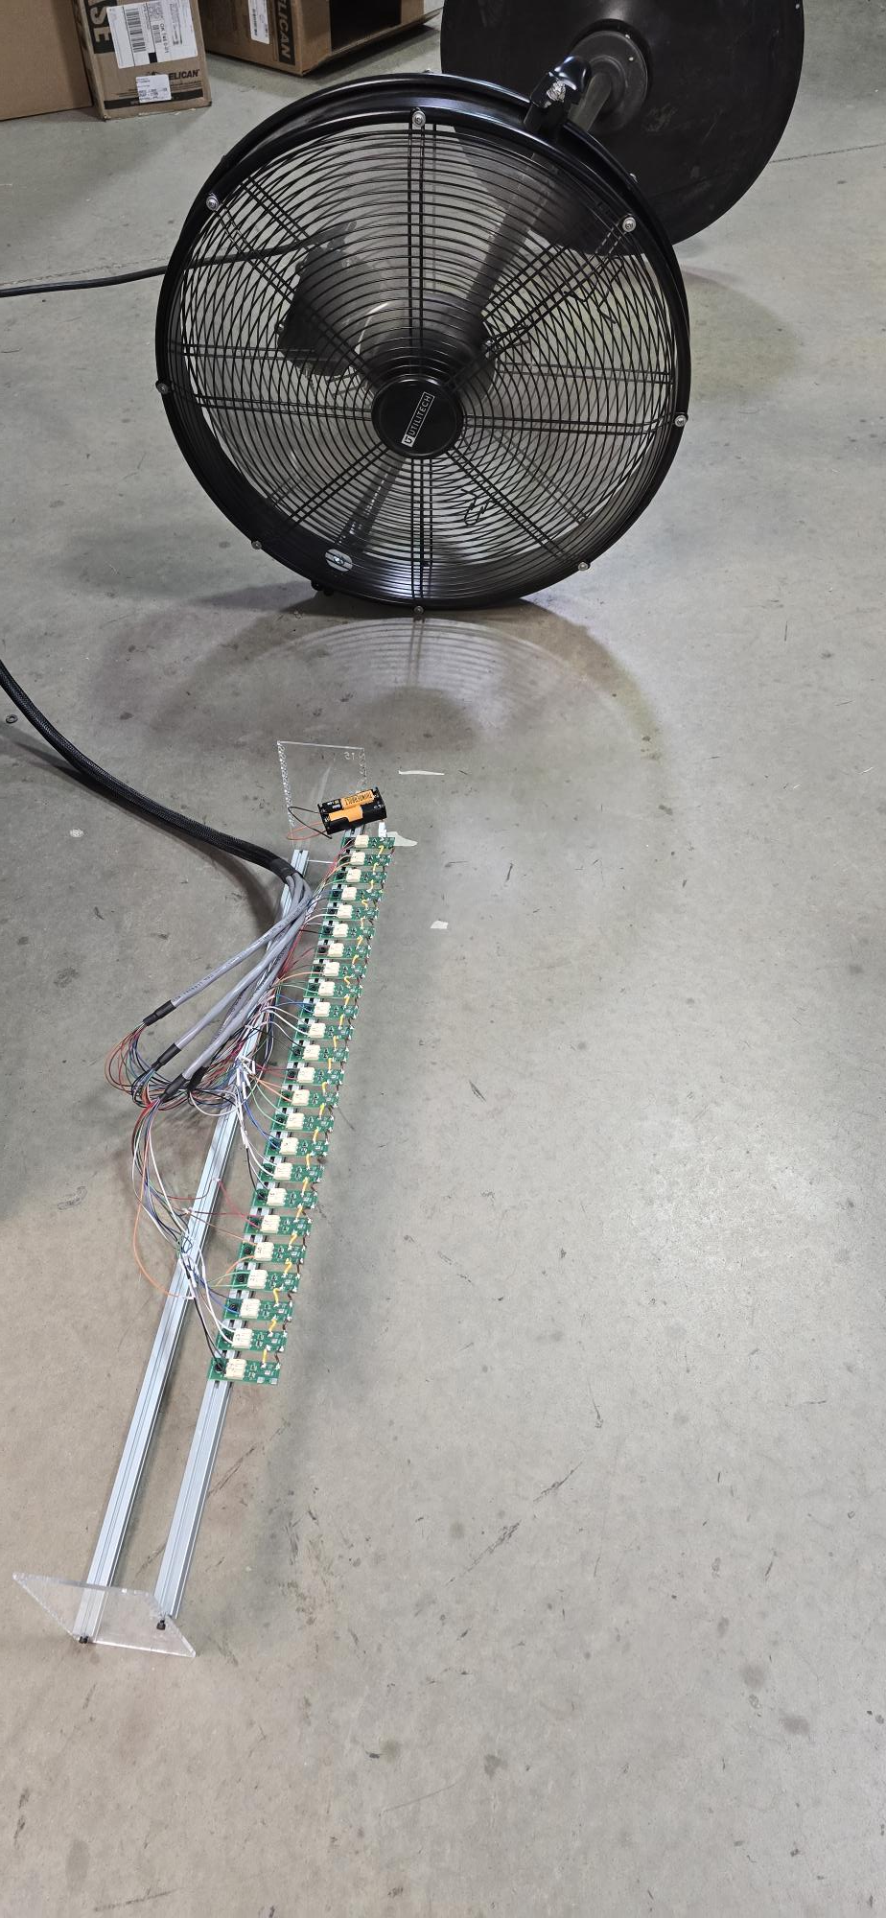
Modular MEMS microphone array
24 microphone array recorded on DAQlink 5
Sampled at 64kSPS
30,000 Hz response
10 times higher resolution

Slide 4
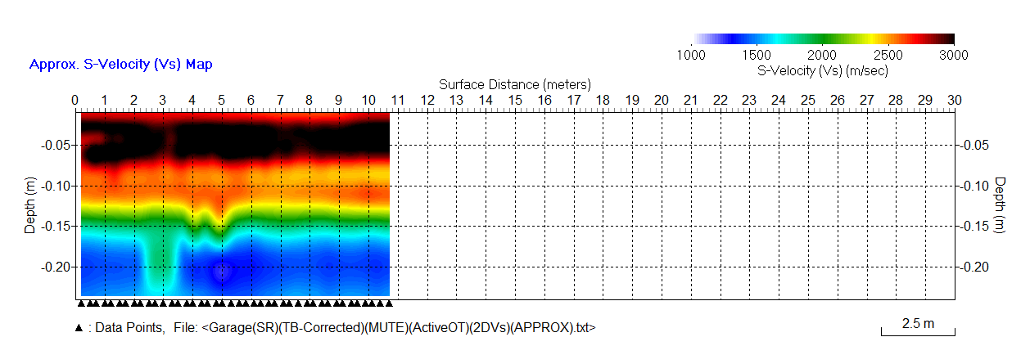
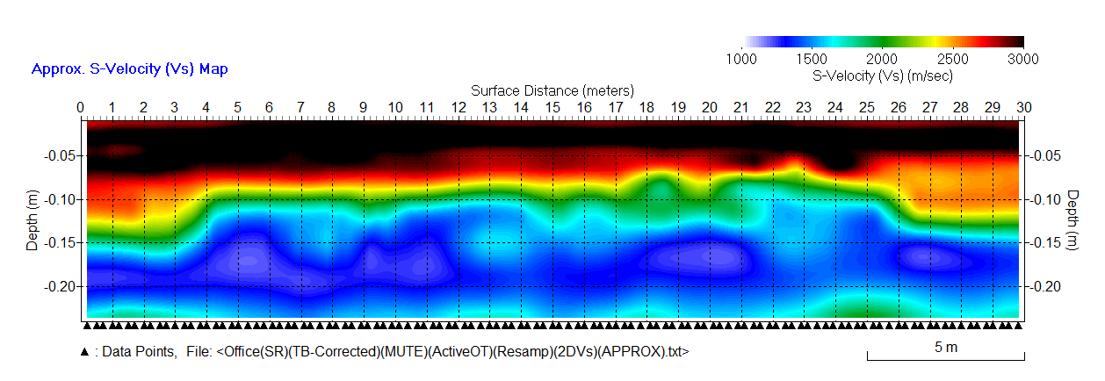
SeisMike - 2D Roll Survey (March 28, 2025)
Inversion of Dispersion Curves
(i.e., Inversion of Extracted “Rayleigh-Wave” Dispersion Curves)
Average velocity (Vs) ≈ 2900 m/s
Average thickness (H) ≈ 15 cm
GARAGE
Vs ≈ 2950 m/s
H ≈ 15 cm
Vs ≈ 3000 m/s
H ≈ 10 cm
Vs ≈ 2950 m/s
H ≈ 15 cm
OFFICE

Slide 5
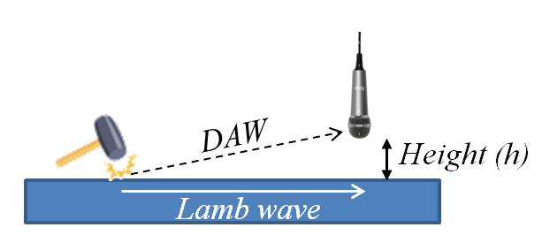
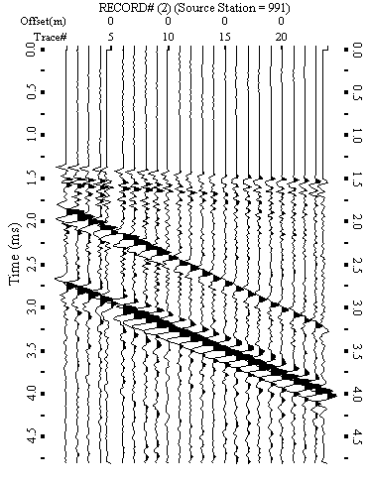
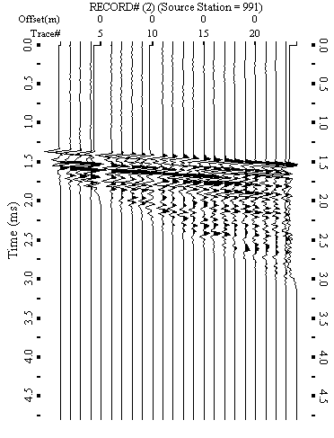
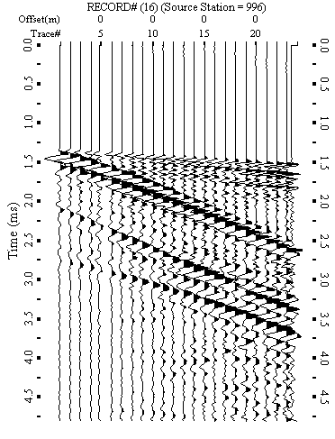
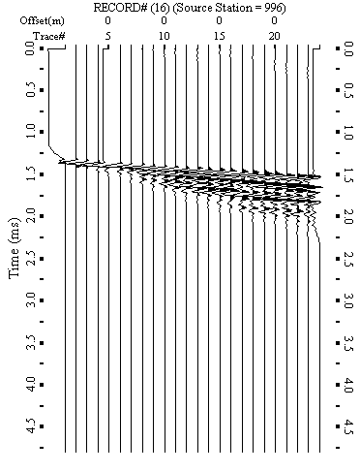
Muting Direct Air Wave (DAW)
Importance of Securing Proper Mute Window
Direct air waves (DAW) are always recorded as the strongest arrivals. If they are not properly muted, any subsequent dispersion analysis will lose the accuracy significantly. It is crucial to secure a proper mute window so that the mute process can be applied without touching valuable Lamb waves (LW). This requires that DAW and LW are well separated in arrival times as illustrated below on left side. The mute process leaves the valuable LW almost intact. On the other hand, if DAW and LW are not well separated, the mute process inevitably alters the LW arrivals as on the right side.
What plays the important role to secure such a window is illustrated in the following pages.
A good mute window is secured by enough difference in arrival times between Lamb wave (LW) and direct air wave (DAW). Muting DAW left most of LW fields intact even for those low-frequency components arriving later (e.g., 2.0-2.5 ms).
Both LW and DAW are arriving tight without much gap in arrival times. In consequence, muting DAW removed significant part of LW energy for those later arriving low-frequency components.
RECORD #2
RECORD #16
RAW
Air Mute
RAW
Air Mute
LW
LW
LW
LW
DAW
DAW
DAW
DAW

Slide 6
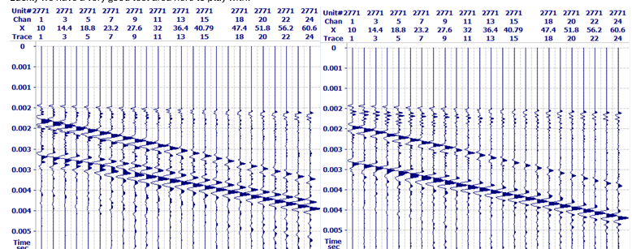
Testing receiver height and source offset
Left is 10cm source offset
Right is 20cm source offset

Slide 7
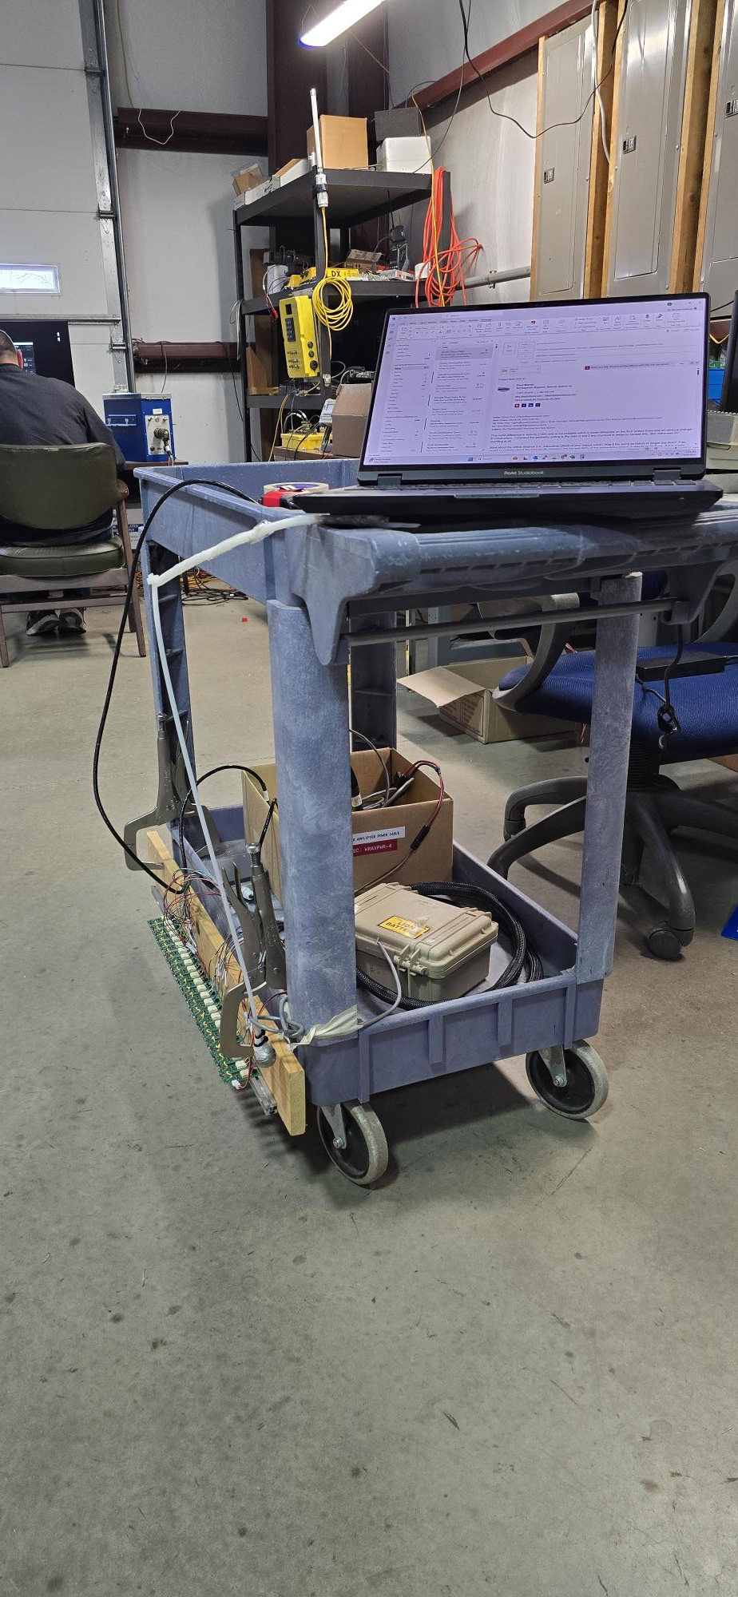
Prototype
System
Deployment
DAQlink 5
GPS location and timestamps
24 ch MEMS array 2.2cm int
Pinball impulsive source

Slide 8
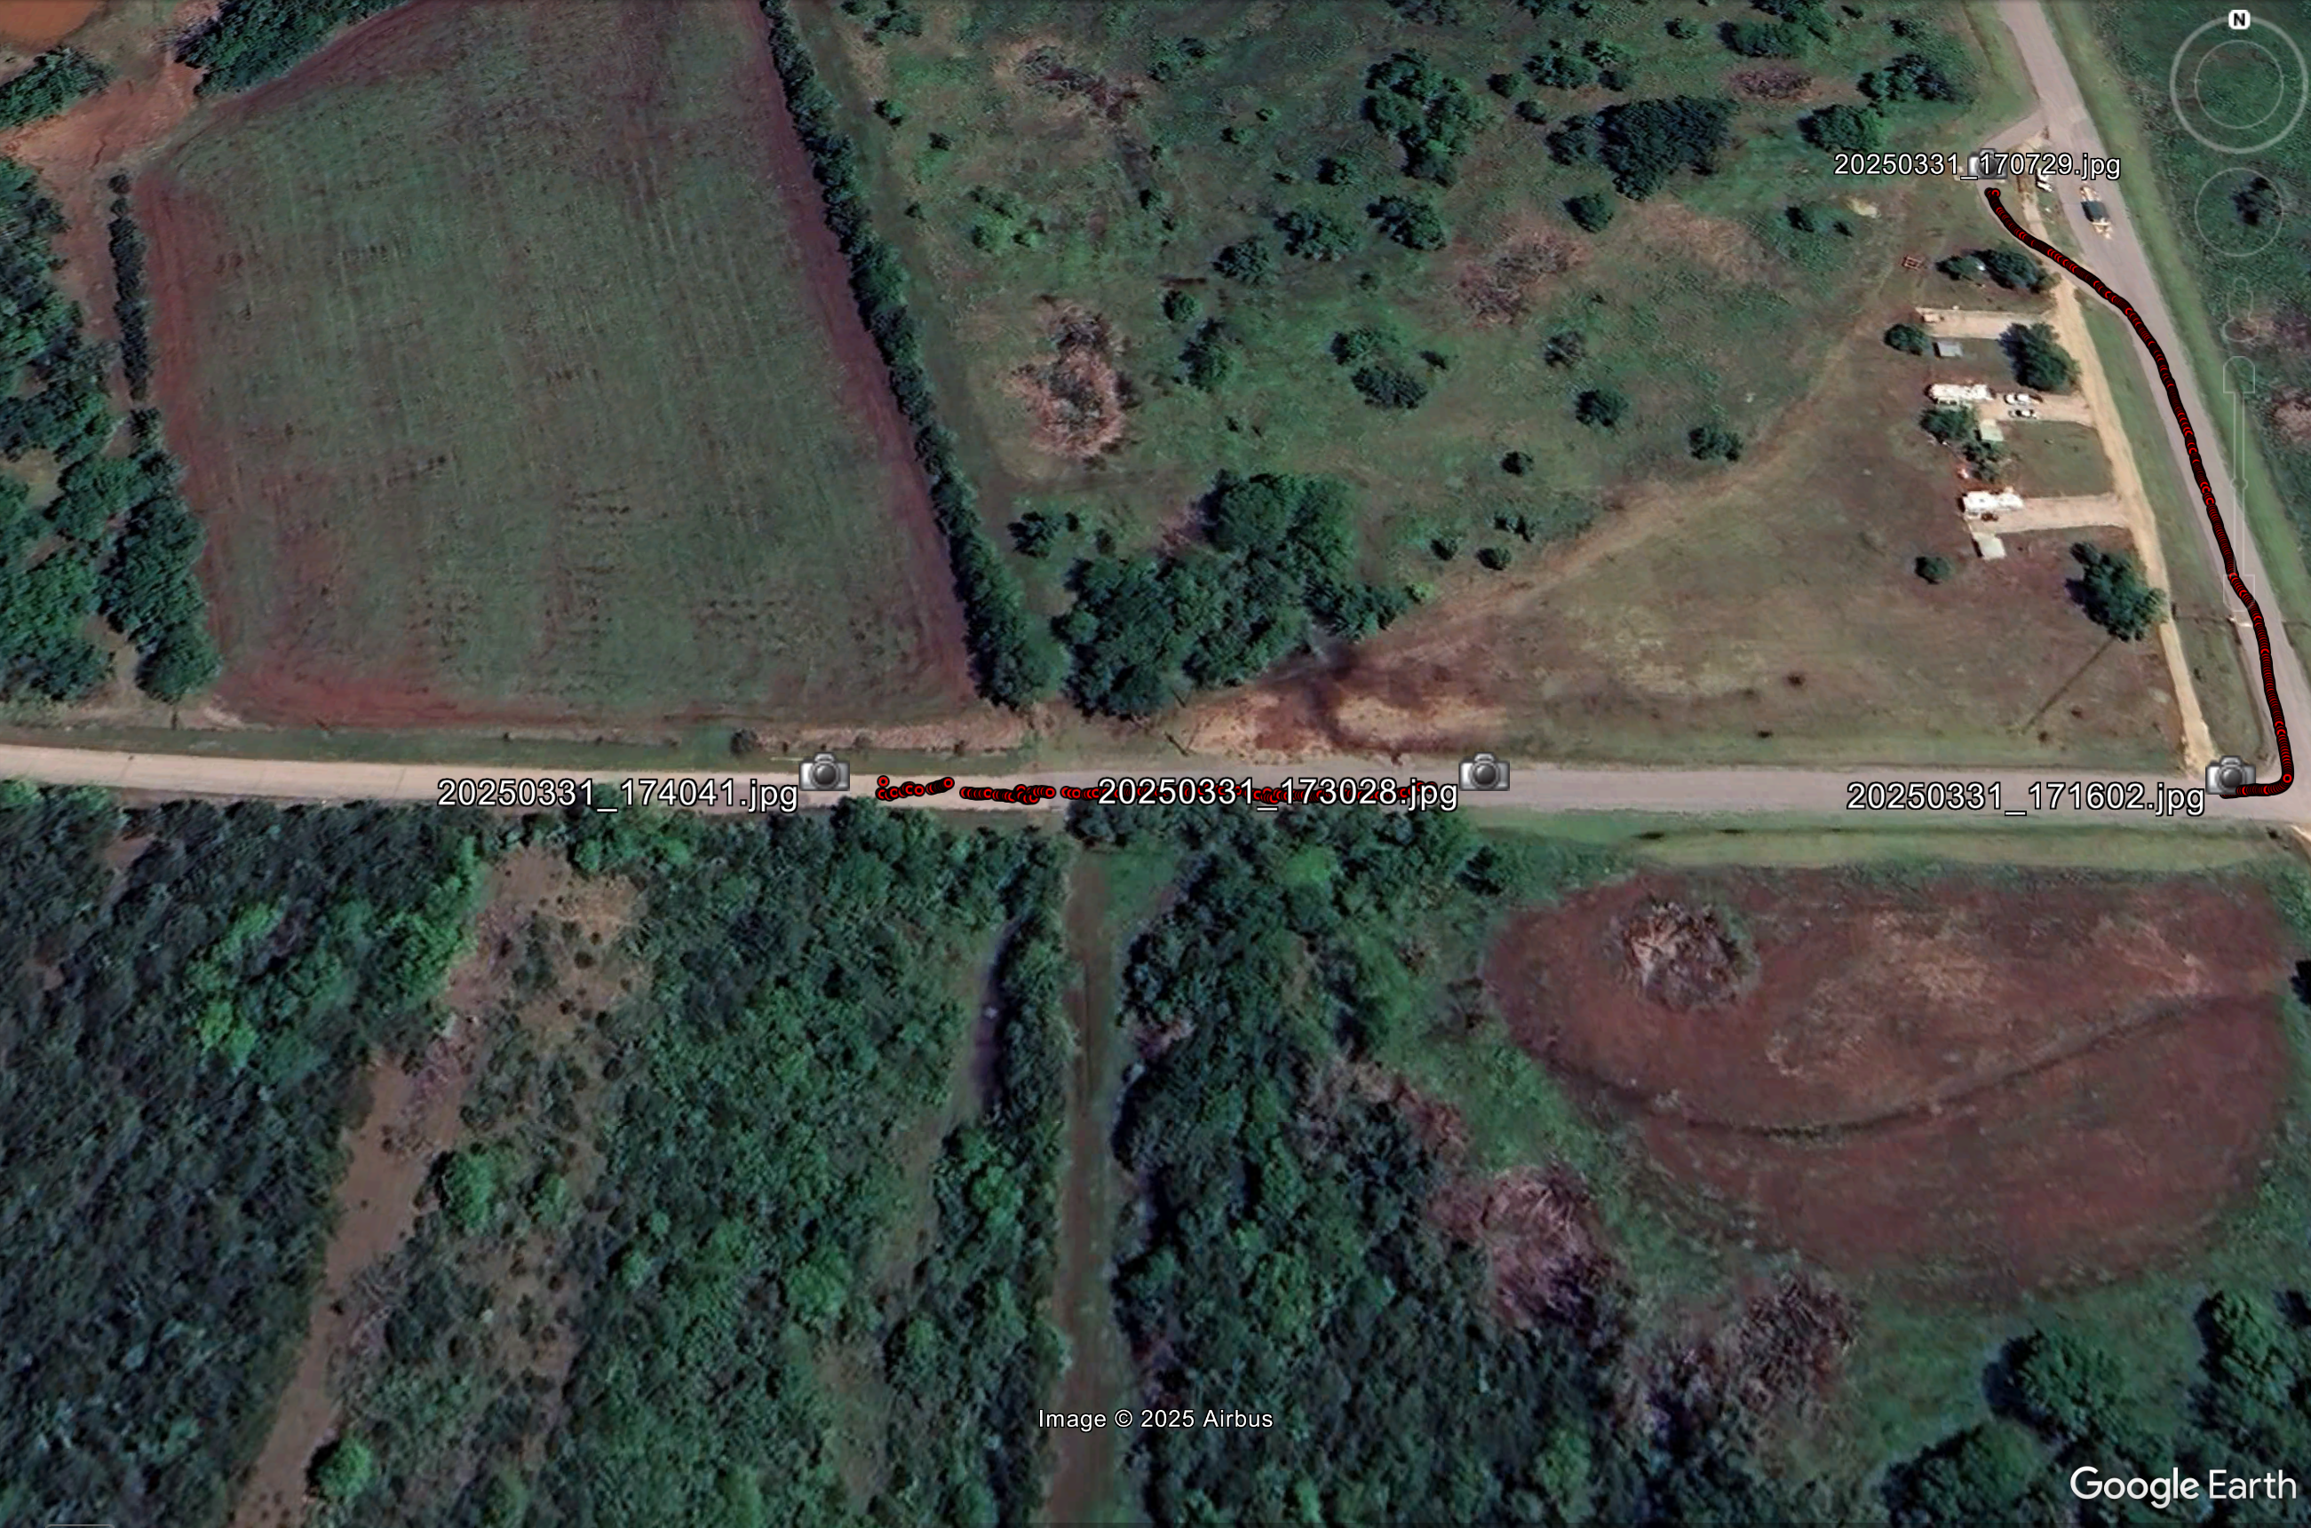

Slide 9
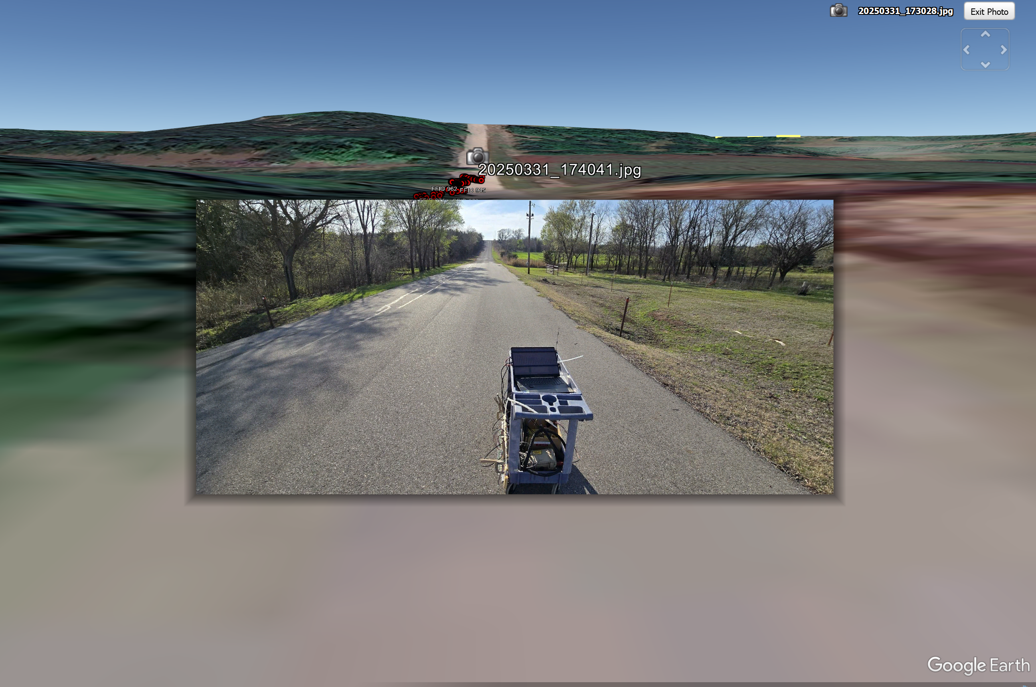

Slide 10
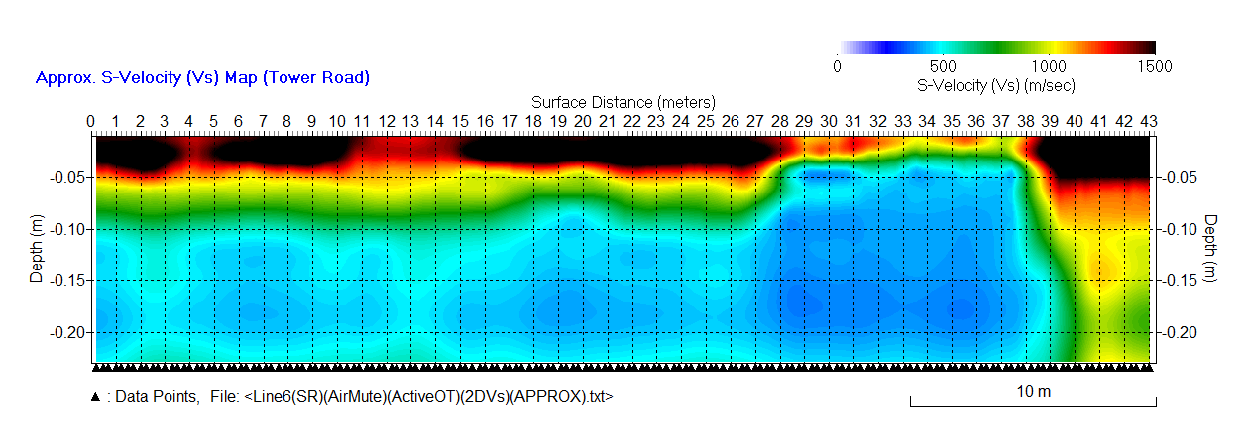
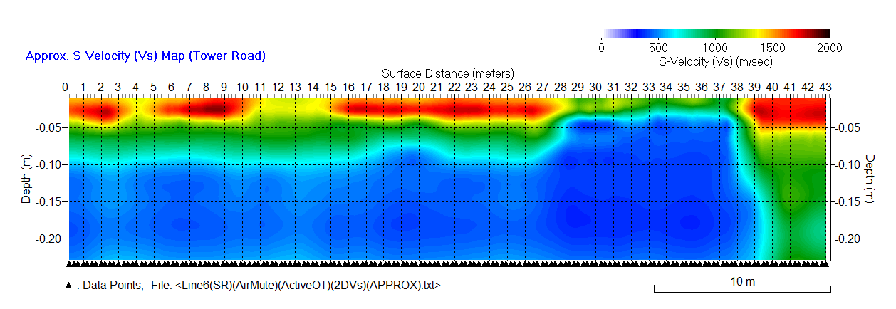
SeisMike-04012025 (“Tower Road”)
Velocity (Vs) Cross Sections Dislayed in Two Different Velocity Scales
A common HMA layer has velocity (Vs) between 1000 (m/s) and 1700 (m/s), which changes with temperature. Depth (thickness) might have been “under-evaluated” by, for example, 10-30%. This is under investigation for the most optimum calibration.
0 (m/s) ≤ Vs ≤ 1500 (m/s)
0 (m/s) ≤ Vs ≤ 2000 (m/s)

Slide 11
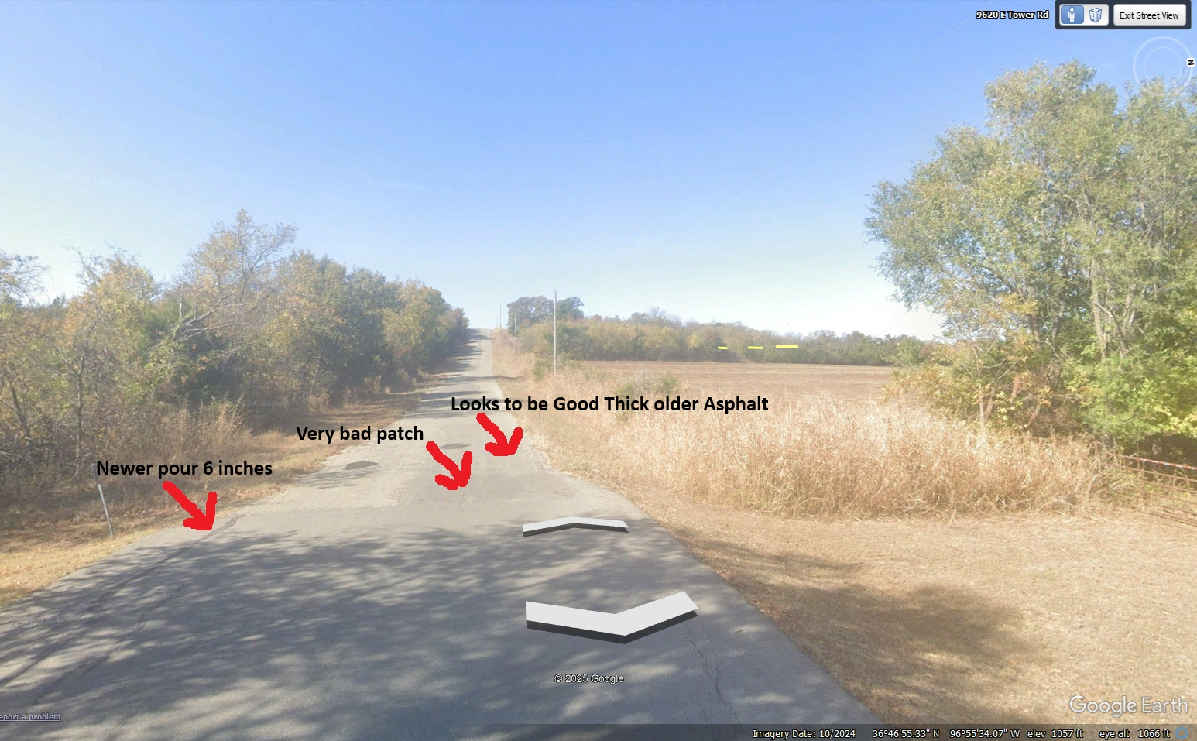

Slide 12
Key Features
High Speed Concrete and Asphalt Evaluation
GPS location and timestamps
Concrete Curing Time
Voids Under Concrete or Asphalt
High Speed Acquisition- Drive Down new pavement
10 times better resolution than previous methods

